Slide 1
Amundsen’s Dogs,
Information Halos, and APIs
The epic story of your API strategy
groups.google.com/group/api-craft
Sam Ramji @sramji
Apigee

Slide 2
AMUNDSEN’S
DOGS

Slide 3
One hundred years ago, in October of 1911

Slide 4
Roald Amundsen

Slide 5
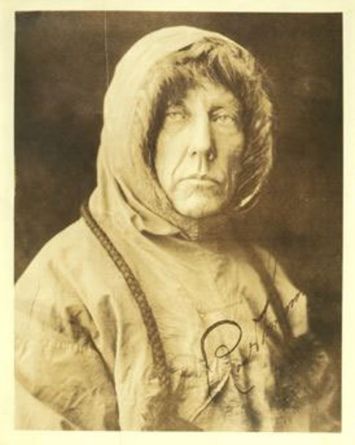

Slide 6
and Robert Falcon Scott

Slide 7
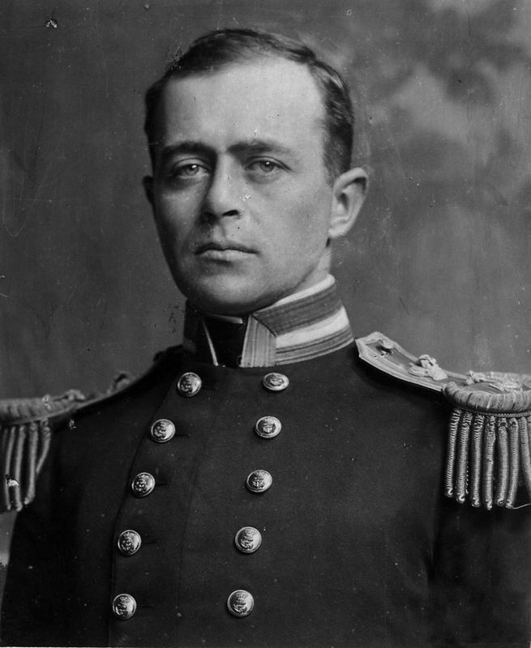

Slide 8
were in a race to reach the South Pole.

Slide 9
The Challenge

Slide 10
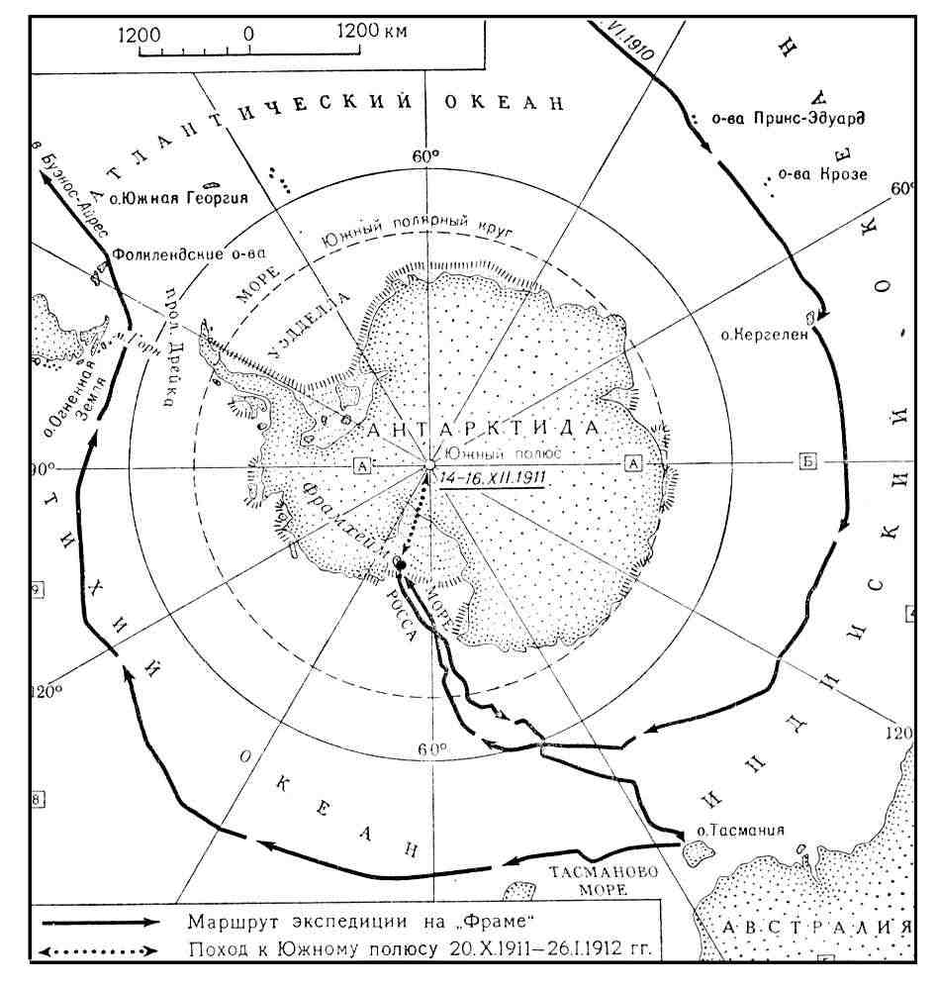

Slide 11
The Stakes

Slide 12
The North Pole was claimed to have been discovered by Cook and Peary.
The South Pole was the sole remaining international prize of discovery.

Slide 13
The Strategy

Slide 14
Amundsen was humble and scholarly.

Slide 15
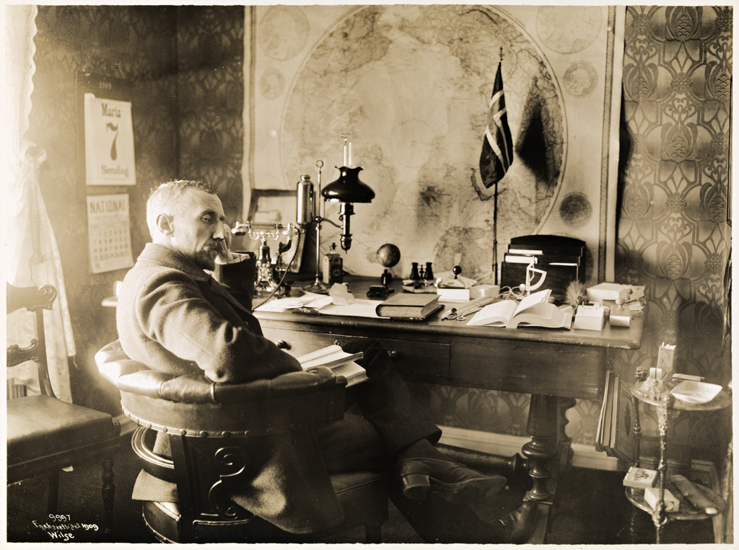

Slide 16
He studied native cultures to understand what worked.

Slide 17
Robert Falcon Scott,
Commander of the Royal Victorian Order,
was an arrogant British naval officer.

Slide 18
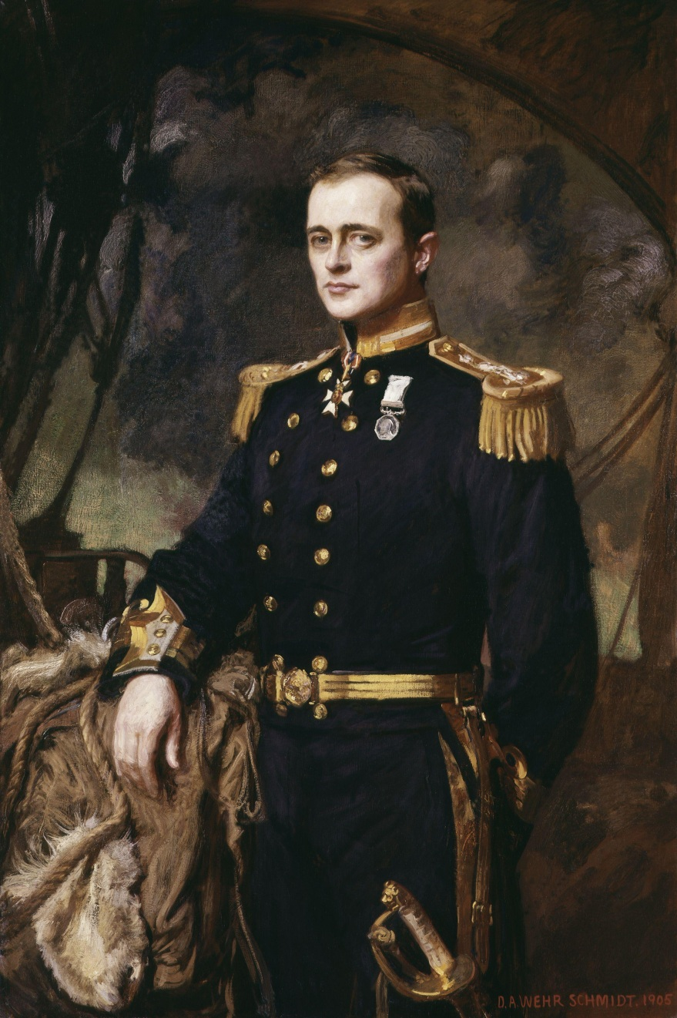

Slide 19
He insisted on doing things the old way.

Slide 20
It came down to a decision about the expedition’s core propulsion.

Slide 21
How do you overcome the challenges of a journey through Antarctic wastes?

Slide 22
Robert Falcon Scott took the traditional route.
Ponies.

Slide 23
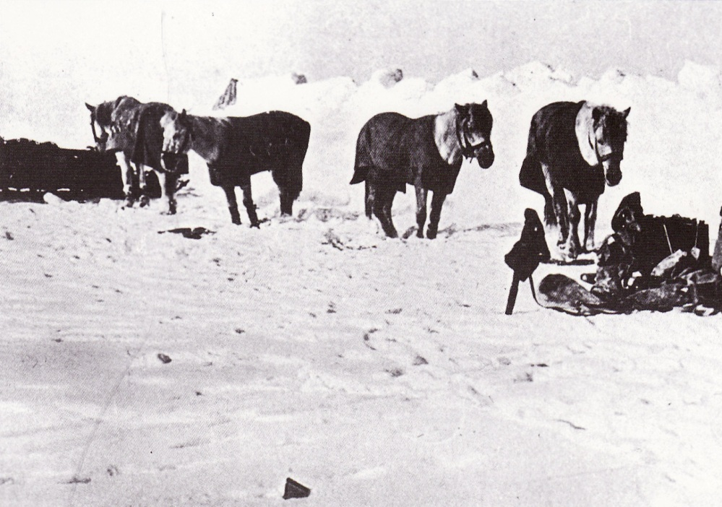

Slide 24
Roald Amundsen followed native wisdom.
He chose dogs.

Slide 25
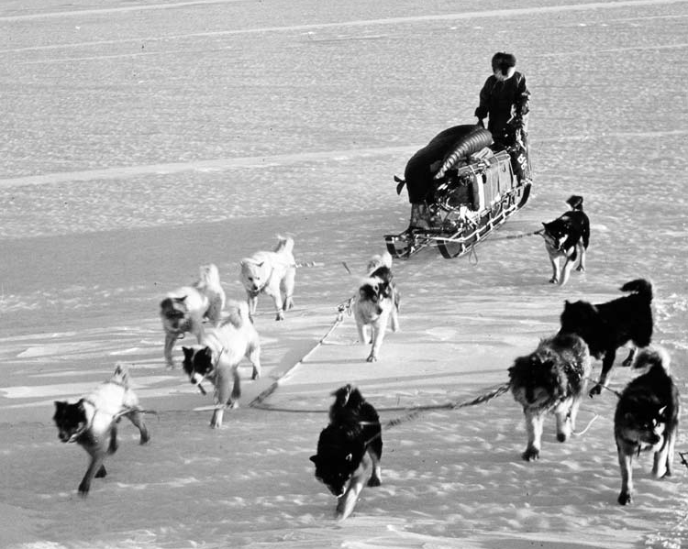

Slide 26
Amundsen led his team of 5 men and 52 dogs to the South Pole and back
a grueling journey of 3,300 kilometers in
-30 C° weather in only 99 days.

Slide 27
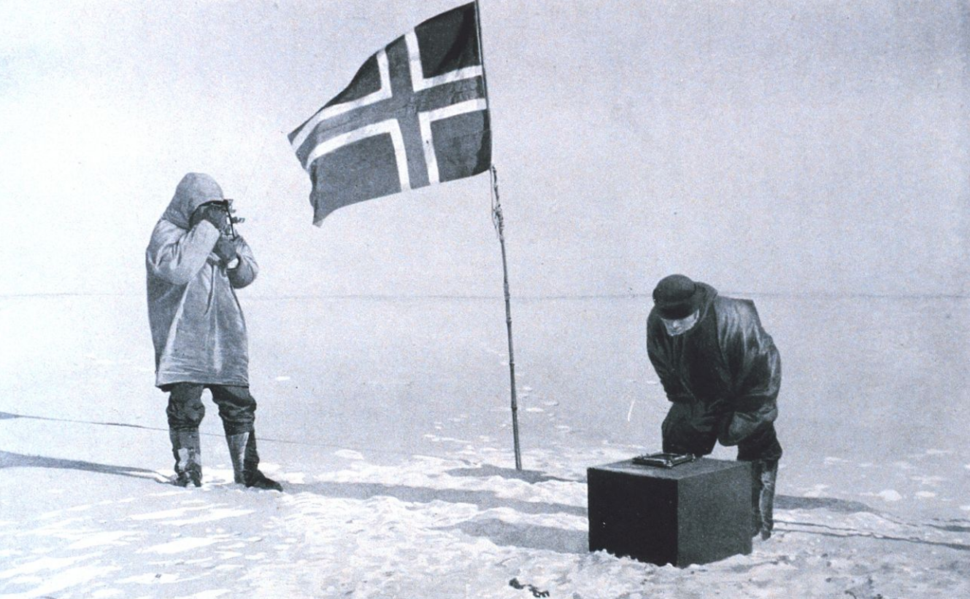

Slide 28
Scott’s team arrived at the South Pole thirty-five days after Amundsen, only to find the Norwegian flag planted in the ground …
… and the tracks of their dogsleds.

Slide 29
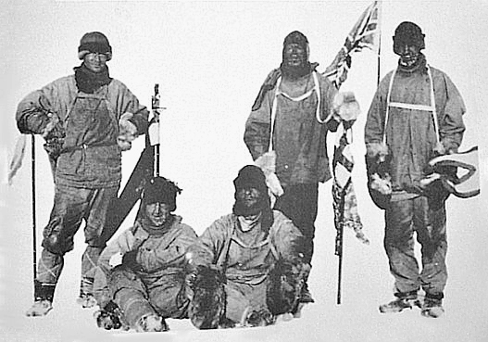

Slide 30
Tragically, Robert Falcon Scott’s entire team died on the way back to their ship.

Slide 31
“
Victory awaits him who has everything in order; luck, people call it.
Defeat is certain for him who has neglected to take the necessary precautions in time; this is called bad luck.
Roald Amundsen
Polar Explorer

Slide 32
INFORMATION
HALOS

Slide 33
We are living through an age of
disruption and value destruction.

Slide 34
Between your core business
and your customers

Slide 35
Core Business
Customers
Value

Slide 36
your old and new competitors
are creating friction

Slide 37
Friction
Core Business
Customers

Slide 38
So you must overcome the friction to win

Slide 39
Apps
Friction
Core Business
Customers

Slide 40
Today’s South Pole is the App Internet.

Slide 41
That is the epic journey.

Slide 42
But apps and platforms
are proliferating so rapidly

Slide 43
Data from Wikipedia

Slide 44
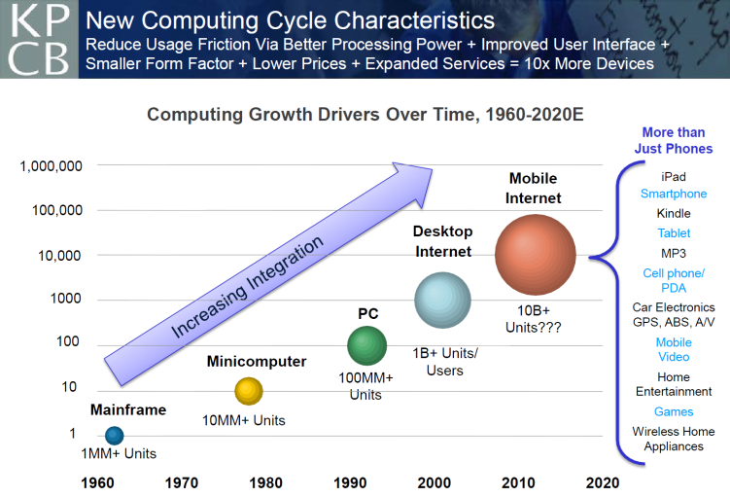
Mary Meeker
Kleiner Perkins

Slide 45
There’s no way the traditional route of relying on IT will get you to this new destination.

Slide 46
So what’s the native wisdom?

Slide 47
Companies who are succeeding

Slide 48









Slide 49
learned that you need to join your IT team
with the world of developers

Slide 50
IT
Developers
Apps

Slide 51
to overcome the friction through
fantastic apps

Slide 52









Slide 53
and deliver your value to the customer

Slide 54
IT
Core Business
Customers
Developers
Apps

Slide 55
and you are about to discover the
information halo.

Slide 56
You remember microeconomics from your college economics course

Slide 57
Complements
Core Business

Slide 58
Reduce the cost of your complements
to drive adoption of your core.

Slide 59
Information is a complement
to your core business.
Reduce the cost of your complements
to drive adoption of your core.

Slide 60
Information Halo
Core Business

Slide 61
your imperative is to enable value added businesses surrounding your own
built on your data

Slide 62
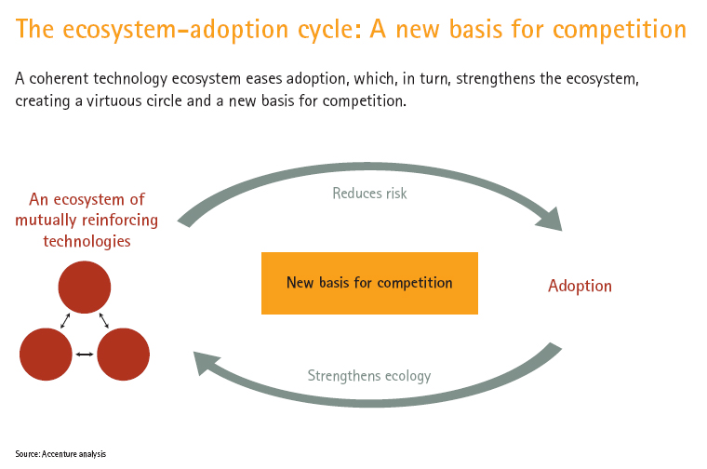
[Ecosystem Competition]
Kishore S. Swaminathan, Chief Scientist, Accenture

Slide 63
It’s about going from information silos
to information halos

Slide 64
“
20th Century IT was about raising barriers to entry for competitors.
21st Century IT is about lowering barriers to participation.
James Governor
Redmonk

Slide 65
Relying only on your own IT

Slide 66
Is like trying to get to the South Pole
using ponies

Slide 68
This is dog country.

Slide 70
API STRATEGY
FRAMEWORK

Slide 71
Just like Amundsen
you are doing your research

Slide 72
So that we can tell the epic story of
your API strategy

Slide 73
Impact a Market Segment
Target the Developer Channel
Set your Goals, Metrics, and KPIs
Manage the Program
Hire your Heroes

Slide 74
IMPACT A
MARKET SEGMENT

Slide 75
market segment
The first step on the journey is to answer the question

Slide 76
market segment
What do you want to achieve?

Slide 77
market segment
You need to start by stating your goal in the following form

Slide 78
market segment
“We will achieve a measurable result
in a specific market segment.”

Slide 79
market segment
There is a cost to consume your product. Reduce this cost through information.

Slide 80
market segment
Product
Price
Promotion
Place
What is the surface area of your product?
How do you increase it?

Slide 81
market segment

Slide 82
market segment
Apps are the intermediaries of today’s market

Slide 84
remember

Slide 85
market segment
Dogs
not ponies

Slide 86
TARGET THE DEVELOPER
CHANNEL

Slide 87
IT
Core Business
Customers
Developers
Apps

Slide 88
developer channel
Why do you care about developers?

Slide 89
developer channel
Because they are your new channel
and your core propulsion

Slide 90
developer channel
Would you have sold to Nordstrom
the same way you sold to Wal-Mart?

Slide 91
developer channel
Of course not.
They’re different.

Slide 92
developer channel
So are developers.

Slide 93
developer channel
You don’t have unlimited resources.

Slide 94

developer channel

Slide 95
developer channel
First, how do we define a developer?

Slide 96
de·vel·op·er noun (də-ve-lə-pər)
: one that develops: as a: a chemical used to develop exposed photographic materials b: a person who develops real estate c: a person or company that develops computer software
Examples of DEVELOPER
<the developer of software that is used the world over>
First Known Use of DEVELOPER
1796
Related to DEVELOPER
Synonyms: contriver, designer, inventor, deviser, formulator, innovator, introducer, originator

Slide 97
developer channel
Definitions I’ve heard:
  Enterprise software company
  Partner
  Games company
  Device manufacturer
  Independent contractor
  News/media company
  Advertising agency
  Hobbyist
  Individual coder
  Startup software company
  Alpha geek

Slide 98
developer channel
Let’s start by calling an individual human a coder.

Slide 99
developer channel
A coder is located in a larger organizational context.
Each exhibits similar behavior and technology adoption patterns.

Slide 100
developer channel
The term "long-tail" is incorrectly applied as a single massive segment of developers.
What businesses should be thinking about is
whether they're working with
known companies
or
unknown coders

Slide 101
developer channel
In many cases building for the unknown coder will help you with your business efforts
with known companies
since unknown coders often work there

Slide 102
developer channel

Slide 103
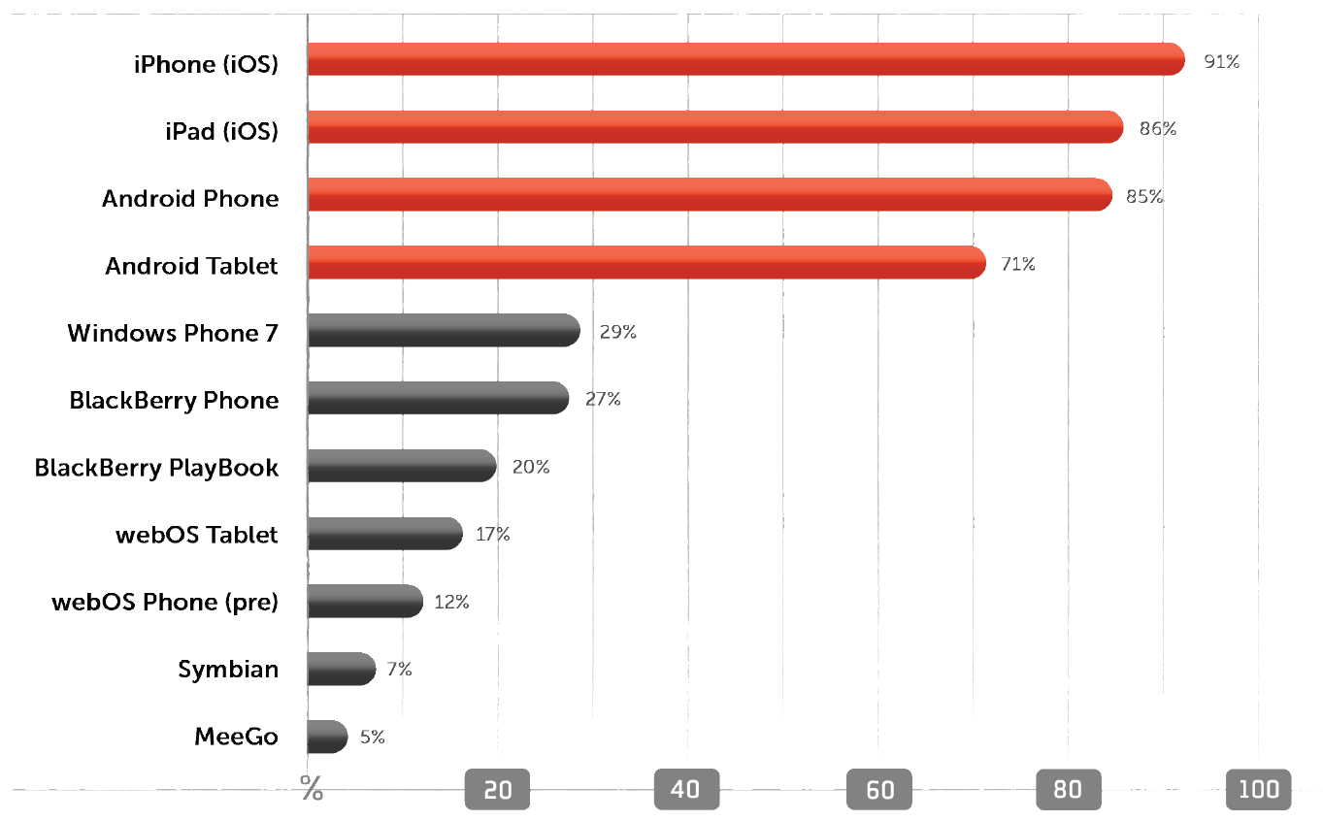
developer channel

Slide 104
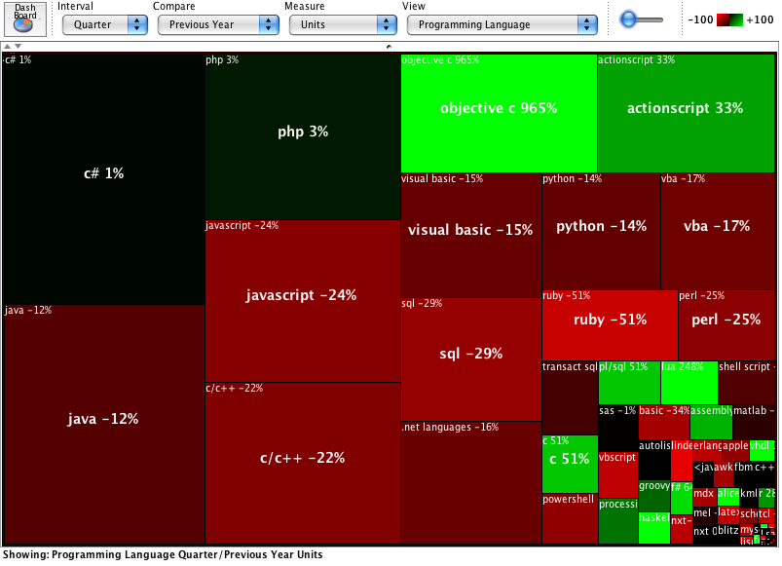
developer channel
Mike Hendrickson, O’Reilly Media (@mikehatora)

Slide 105
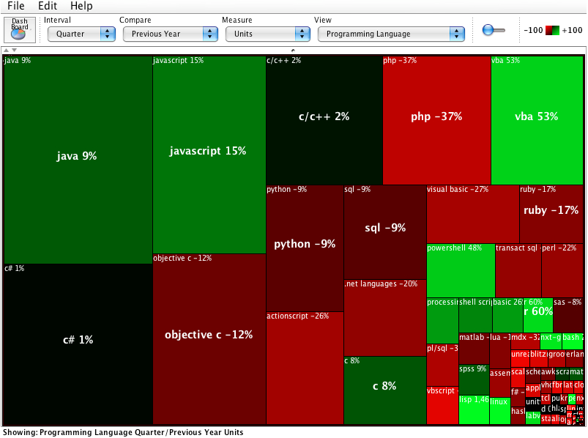
developer channel
Mike Hendrickson, O’Reilly Media (@mikehatora)

Slide 106
developer channel
Horizontal
Vertical
Tribal
Modal

Slide 107
developer channel
Horizontally
LARGE ECOSYSTEM Players
LARGE ENTERPRISES
ISV
SYSTEM INTEGRATORS
SMB | SMALL ENTERPRISE
SAAS
SOFTWARE STARTUPS
HOBBYIST |OPPORTUNIST

Slide 108
developer channel
Vertically
Social media
mobile
retail
Digital media
publishing
Financial services
hospitality
logistics
AIRLINES
TELECOMMUNICATIONS

Slide 109
developer channel
Tribally
SproutCore
jQuery
CoffeeScript
Ruby
AWS
Sencha
JavaScript
Rails
Heroku
HTML5
Backbone.js
dojo
Node.js
C#
PHP
iOS
Android
Monotouch
Objective-C
Scala
Java

Slide 110
developer channel
Modally
Public
Open
Technology
Closed
Access
Private

Slide 111
developer channel
Incentives that match the vertical and horizontal coordinates you’re targeting

Slide 112
developer channel
Horizontally
LARGE ECOSYSTEM players
PAY them
Medium & LARGE ENTERPRISE
Show them opportunity
ISV
Business development
SYSTEM INTEGRATORS
Show Customer demand
SMB | SMALL ENTERPRISE
Microsoft ecosystem
SAAS
efficiency
SOFTWARE STARTUPS
Free and cool
HOBBYIST |OPPORTUNIST
free

Slide 113
developer channel
Vertically
Social media
mobile
retail
Digital media
publishing
Financial services
hospitality
logistics
AIRLINES
Be at meetups and conferences that coders in the vertical already go to. Have a relevant offer.
TELECOMMUNICATIONS

Slide 114
developer channel
Tribally
C#
jQuery
CoffeeScript
SproutCore
Formal
Industry events
Forums
Existing communities
dojo
JavaScript
Ruby
HTML5
backbone.js
Heroku
Rails
Sencha
Node.js
Informal
iOS
Meetups, hackathons
Beer and coffee
Inside your company?
Twitter
Stackoverflow
hackernews
Android
AWS
PHP
Java
Scala
Offline
Online

Slide 115
developer channel
Modally
Public
Publish your api
Advertise on coder sites
Establish a contest
Open
Technology
Closed
Access
Evangelize within your partners’ development teams
Advertise your
business model
Private

Slide 116
IT
Core Business
Customers
Developers
Apps

Slide 117
SET YOUR
GOALS, METRICS & KPIs

Slide 118
goals, metrics & kpis
You manage what you measure

Slide 119
goals, metrics & kpis
What is measured increases

Slide 120
goals, metrics & kpis
so it had better be aligned with the business

Slide 121
goals, metrics & kpis
Developer Satisfaction
Breadth Developers (Coders)
Depth Developers (Partners)
Apps
Active Apps
Utilization
Users
Market Share (for your industry/service)
Market Share (devices)
Revenue
Protected Revenue
Margin

Slide 122
goals, metrics & kpis
Metric | Quarterly Target | Quarterly Actual | Annual Target
Developer NSAT
Breadth Developers
Depth Developers
Apps
Active Apps
Utilization
Users
Market Share
Revenue
Protected Revenue
Margin
Establish the source and rhythm of measurement for each metric

Slide 123
MANAGE THE
API PROGRAM

Slide 124
“
Victory awaits him who has everything in order; luck, people call it.
Defeat is certain for him who has neglected to take the necessary precautions in time; this is called bad luck.
Roald Amundsen
Polar Explorer

Slide 125
 | Planning | Management | Organization
Target Segment | DEFINE | MEASURE | MARKETING
Engage Channel | INCENT | RECRUIT | CHANNEL
Build Platform | SPECIFY | BUILD | IT

Slide 126
 | Planning | Management | Organization
Target Segment(s) | Define market segment in detail including size and user persona; specify API profile needed to satisfy top use cases for each target segment | Establish KPI targets, traceability and dashboard | Marketing-led Segment-oriented workstreams
Engage Channel | Specify business model and marketing driver for the channel that will reach each target segment | Establish developer adoption targets, developer marketing and channel actions (community site, events, and communication) | Channel-led Community, developer, and business development workstreams
Build Platform | Specify roadmap of API deliverables, mechanics, integration, and business process to meet target segment needs | Implement API roadmap, adjust and report on iteration cycle, and establish alpha developer team | IT-led API, infrastructure, and developer support workstreams

Slide 127
program management
The humans in these organizations need to communicate with each other.
Create an internal information halo.

Slide 128
HIRE YOUR
HEROES

Slide 129
hire your heroes
The traditional approach
to technology projects

Slide 130
hire your heroes
would call for
project managers,
product managers,
architects,
and would be internally focused on IT

Slide 131
hire your heroes
But just like the ponies didn’t make it

Slide 133
hire your heroes
You’ll need a different breed to win in APIs

Slide 134
hire your heroes
THESE ARE REAL JOBS
Channel Leader
Developer Evangelist
Developer Advocate
Community Manager
Data Scientist
Developer Experience Specialist

Slide 135
hire your heroes
The information halo works internally as well.
It can attract the right people from within your company to join your API team.

Slide 136
 | Accountabilities | Organization
Target Segments | Meet KPI targets, Segment messaging and positioning, use-case requirements driven to Engineering | FTE: Marketing Marketing Leader Segment Leads
Engage Developers | Meet developer adoption targets, community engagement, developer support | FTE: Channel Developer Evangelist Community Managers
Establish Platform | Implement roadmap based on marketing requirements, drive platform requirements, meet delivery timeline and scalability | FTE: Engineering Engineering Lead Software Engineers QA Engineers

Slide 137
hire your heroes
While you’re going to need outstanding people to make this happen

Slide 138
hire your heroes
Keep in mind
they don’t all start out looking like this

Slide 139


Slide 140
hire your heroes
They may not look like they are up to the job

Slide 141


Slide 142
hire your heroes
But if you enable them to succeed they will get stronger and faster
And you won’t be able to hold them back.

Slide 143
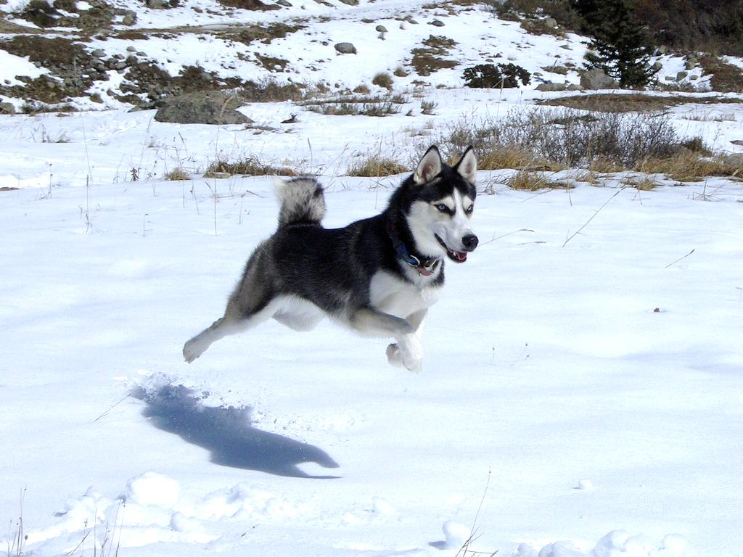

Slide 144
FINAL THOUGHT

Slide 145
Information halos are better than
information silos

Slide 146
Let’s create an information halo around APIs

Slide 147
groups.google.com/group/api-craft

Slide 148
THANK YOU
Questions and ideas to:
@sramji
groups.google.com/group/api-craft

